Slide 1
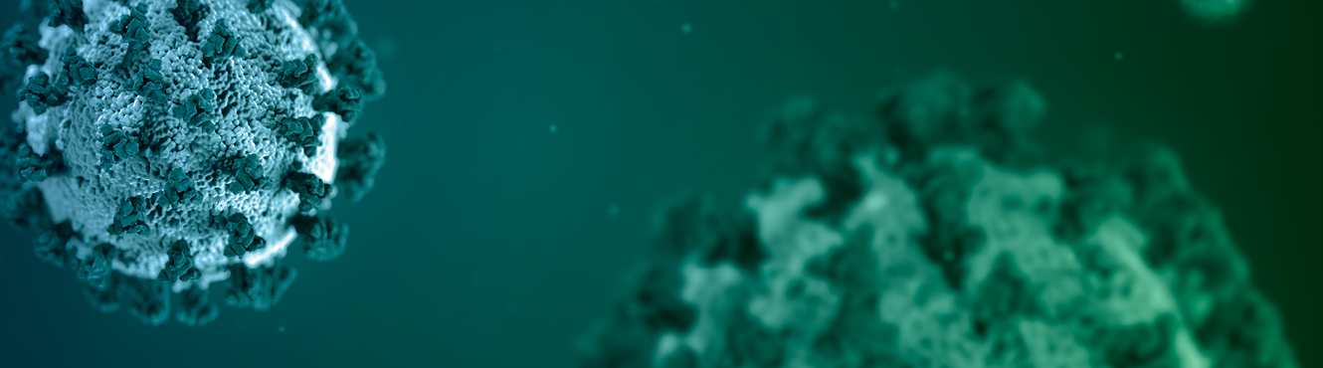
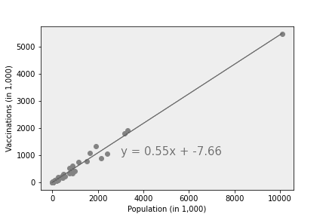
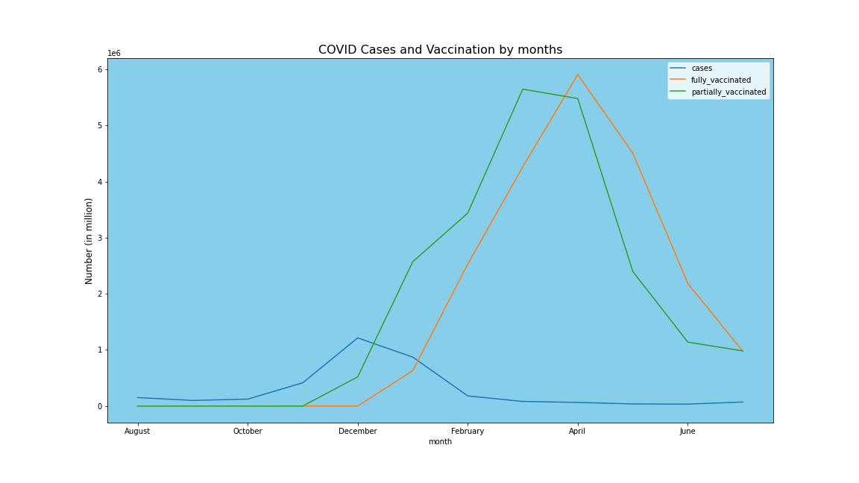
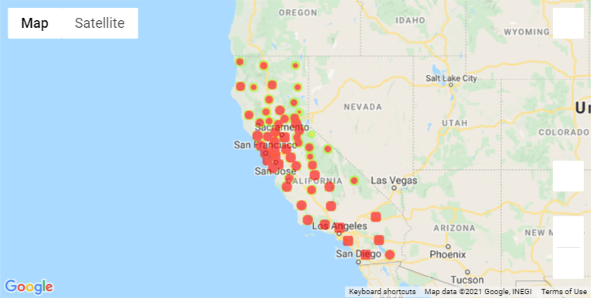

COVID-19 Vaccination California
Team members:
- Tikaram Subedy
- Kristian Hamilton
- David Koski

Slide 2
Project analysis slide 2
Project Outline
Reporting and Presentation
Data collection and Source
Analysis of COVID 19 Vaccination
California
Analyzing Statistically
Data Cleaning using Pandas Jupyter Notebook
Generating plots and charts
Data Slicing, merging and aggregating

Slide 3
Project analysis slide 3
Project Plan
California Data
Data Cleaning and Preparation
ANALYSIS
Trends and Charts
Report and Presentation
Performed Analysis on
Overall California, and Counties in Cases, Demographics, and Vaccinations
Cases, Vaccination and Demographic data
Data Cleaning and Preparation using Python and Pandas in Jupyter Notebook
Cases and Vaccination trends were analyzed.
Fitted regression models (linear)
Prepared data analysis report. Recommendations and further ……

Slide 4
Summarize where and how we found the data used to answer these questions
Importing COVID19 data and preparing it for the analysis by slicing and aggregating.
Deciding on and calculating a good measure for analysis.
Merging datasets and finding correlations among the dataset.
Visualizing the analysis results using Pandas and Matplotlib.

Slide 5
What Affects Vaccination in CA?
How is the vaccination trend in overall CA as well counties?
Is there a relationship between cases and deaths that has affected in vaccination?
Do demographics affect on vaccination?
Does location and time affect vaccination?

Slide 6
Is there a correlation between cases and deaths affect vaccination rates?

Slide 7
Do demographics affect vaccination rates?
Kristian

Slide 8

Project analysis slide 5
Analysis
After the vaccination started in December and made available to wider range of population, the cases showed a dropping trend and remaining low.
Total Population in California
Completely Vaccinated
Partially Vaccinated
39,283,497
21,025,768
(53.52%)
22,224,679
(56.57%)

Slide 9
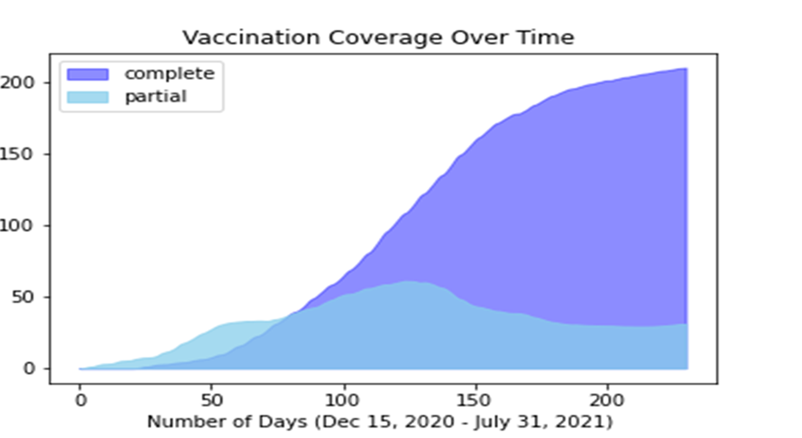

Slide 10
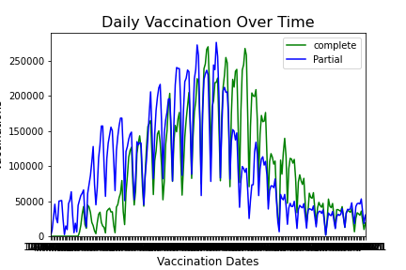
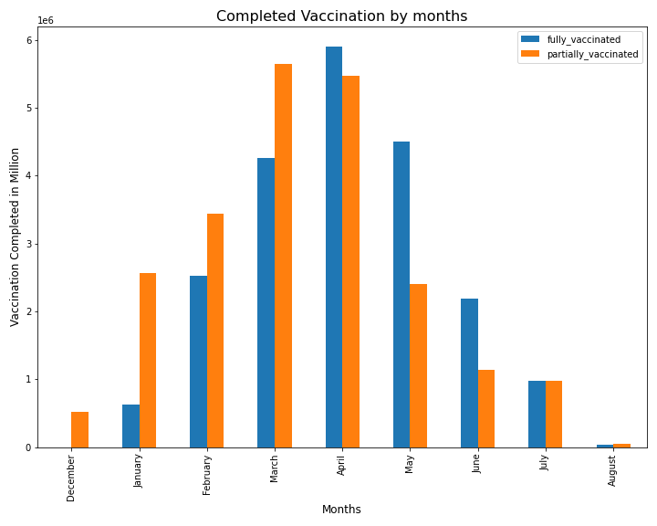
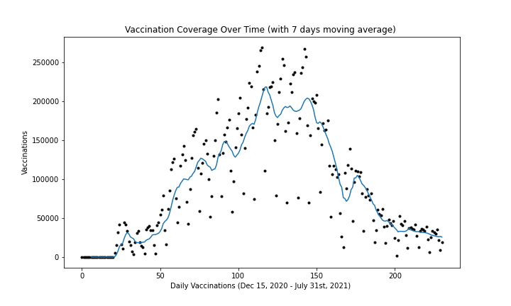
Project analysis slide 5
Analysis

Slide 11
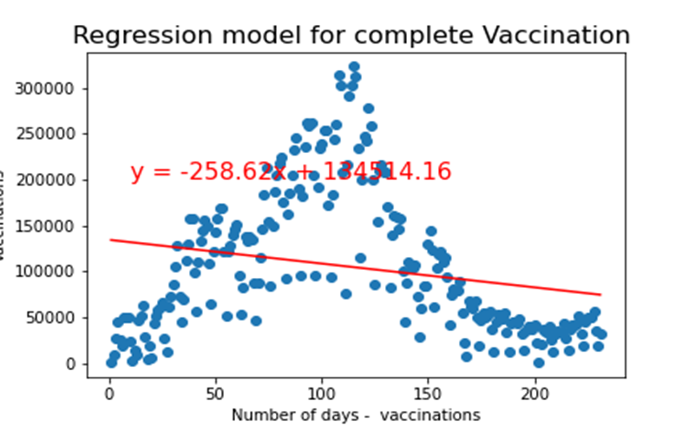
The statistics shows, it can be estimated that the vaccination in California will be completed in about 521 days from the beginning, while all other compounding factors remain unchanged.

Slide 12
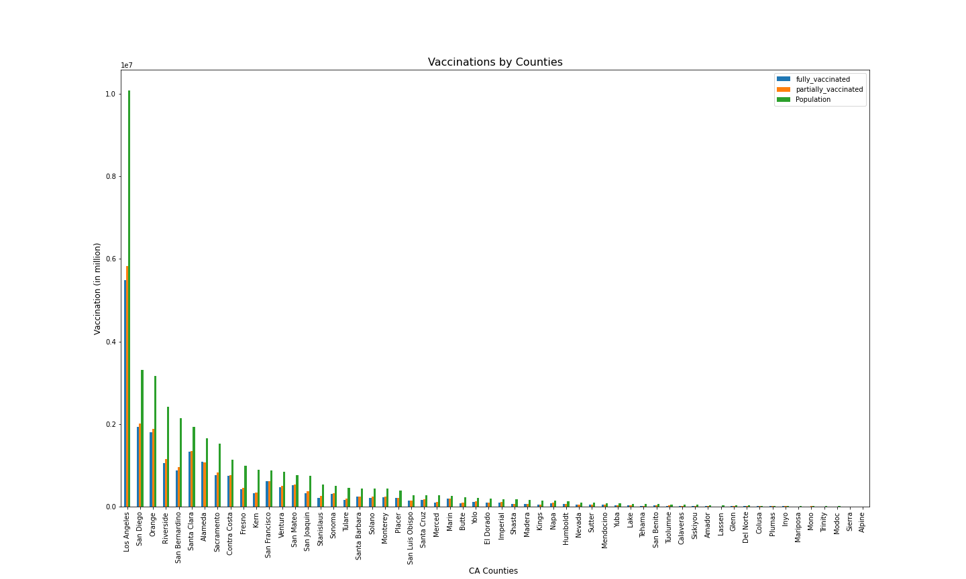
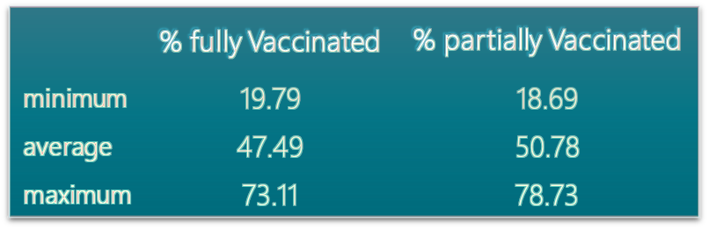
Analysis
Variation in the average percentage of vaccination is observed by population among counties
The vaccination percentages for counties varies from less than 20% to more than 70%.
- Highly vaccinated counties are Marin county and San Francisco county where the % vaccination is higher than 70%.
- Lassen county has the Lowest percentage of vaccination (less than 20% )

Slide 13
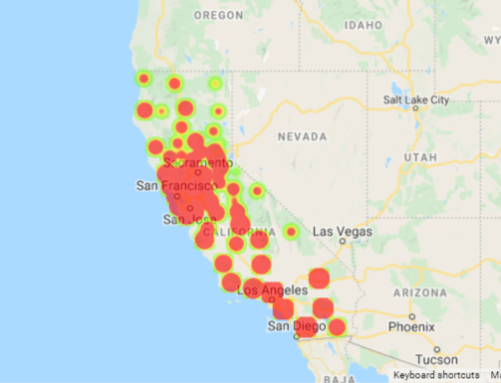
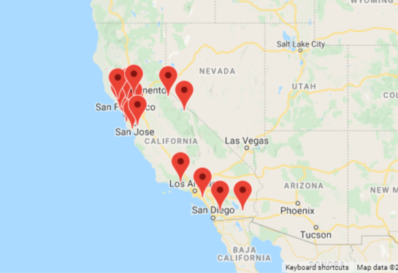
Locations and vaccination
Urban and highly populated counties are found to have higher vaccination compared to the rural and less populated counties.
Counties - Complete Vaccination
Counties- higher average vaccination than State average

Slide 14
California Health and Human Services Covid-19 Vaccination Data by County
Kristian
Summarize where and how you found the data you used to answer these questions

Slide 15
Federal Census Bureau American Community Survey Data by County
Kristian
Summarize where and how you found the data you used to answer these questions

Slide 16
USAFacts.org
David
Summarize where and how you found the data you used to answer these questions

Slide 17
Data Cleanup Tikaram
Data source:
- CDC data (in csv format)
-
Describe the data exploration and cleanup process (accompanied by your Jupyter Notebook)

Slide 18
Data Cleanup David
Describe the data exploration and cleanup process (accompanied by your Jupyter Notebook)

Slide 19
Data Cleanup Kristian
Describe the data exploration and cleanup process (accompanied by your Jupyter Notebook)

Slide 20
Describe the Analysis Process
Screen shots of code and output
Describe the analysis process (accompanied by your Jupyter Notebook)

Slide 21
Describe the Analysis Process
Screen shots of code and output
Describe the analysis process (accompanied by your Jupyter Notebook)

Slide 22
Describe the Analysis Process
Screen shots of code and output
Describe the analysis process (accompanied by your Jupyter Notebook)

Slide 23
Average Percentage of Vaccination by County
The data shows that there is no wider gap on average percentage of vaccination (partial or complete) in majority of the counties in California.

Slide 24
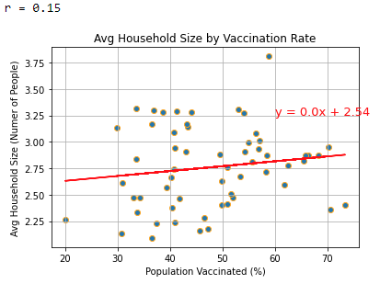

Slide 25
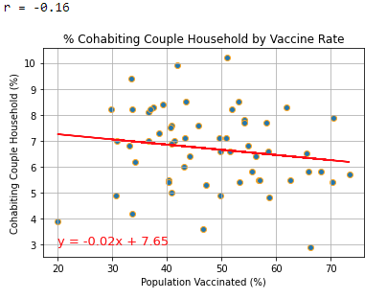
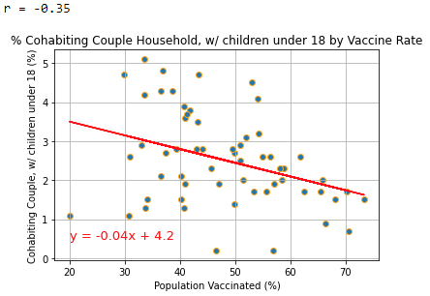

Slide 26
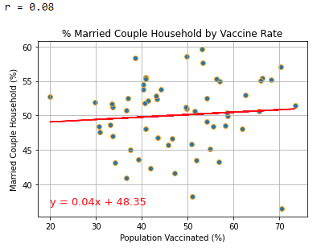
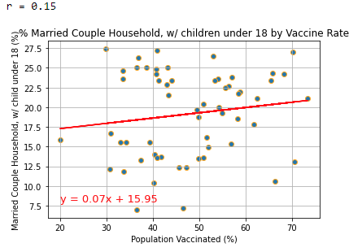

Slide 27
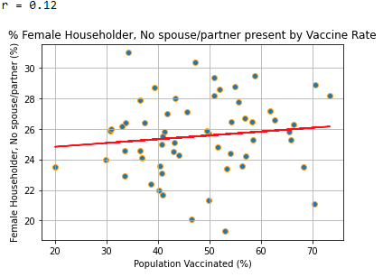
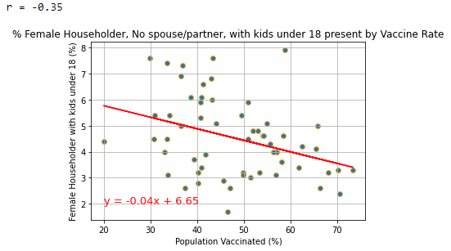

Slide 28
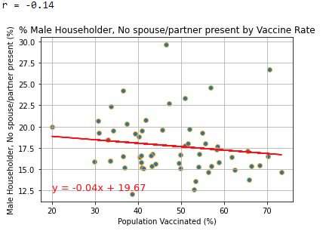
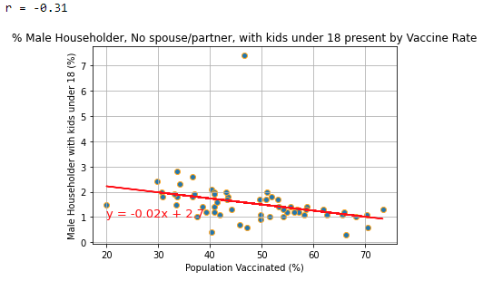

Slide 29
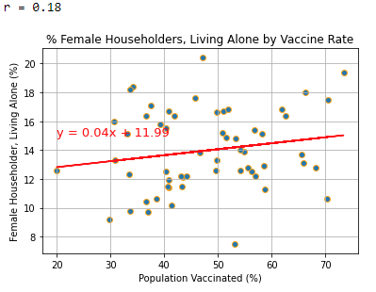
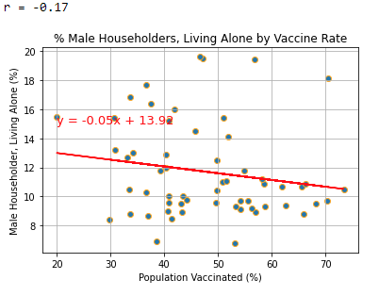

Slide 30
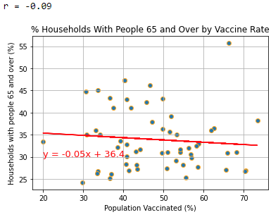

Slide 31
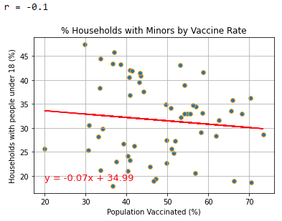

Slide 32
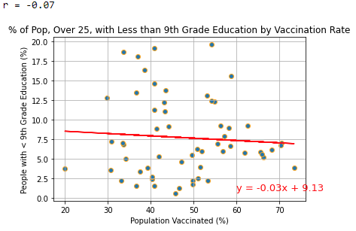

Slide 33
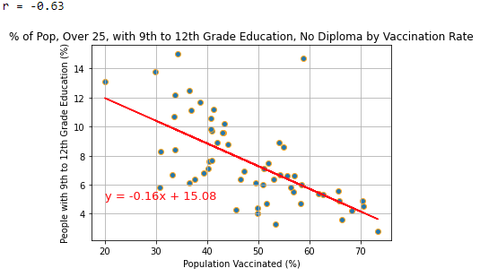

Slide 34
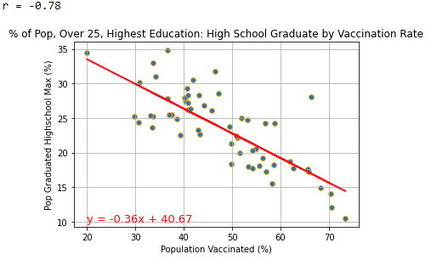

Slide 35
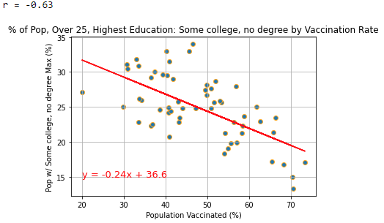

Slide 36
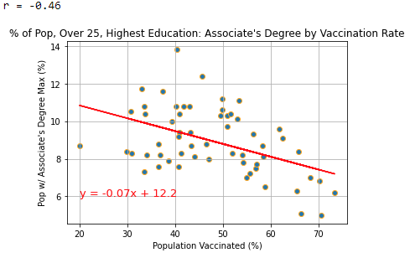

Slide 37
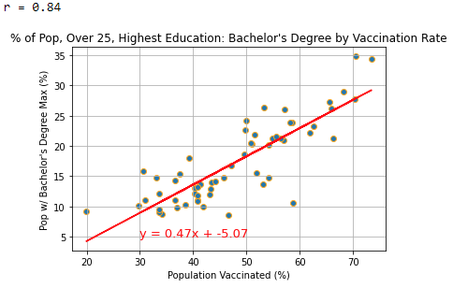

Slide 38
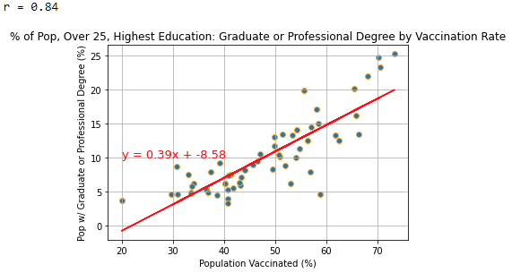

Slide 39
Limitations

Slide 40
Recommendations

Slide 41
Thank You

